Slide 1
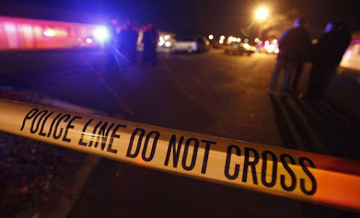
Kansas City Crime Analysis
By: Tina Sparks, Sarah Martin, Jai Dayal, Lesley Chubick, Thomas Lippoli

Slide 2
Our Research

Slide 3
Data Sources

Slide 4
Scrubbing Our Data

Slide 5
Coding Tools & Programs Used

Slide 6

MapBox

Slide 11
Questions?

